Slide 1

Presenter Name
Date

Slide 2

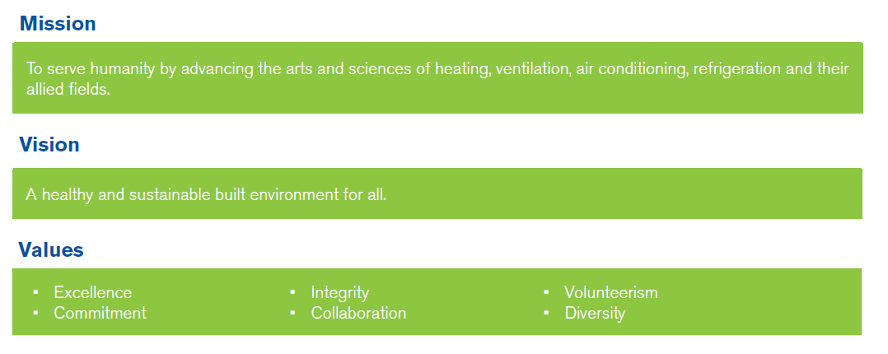
ASHRAE Society Mission, Vision and Values
Notes:
Let’s start with ASHRAE as a whole and then drill down to how Communications Committee fits in. We’ll then spend some time on how Communications Committee can help YOU. Everything ASHRAE does is guided by its Mission, Vision and Values as well as a Strategic Plan. Each year there is also a Society Theme inspired and presented by the current ASHRAE president.

Slide 3
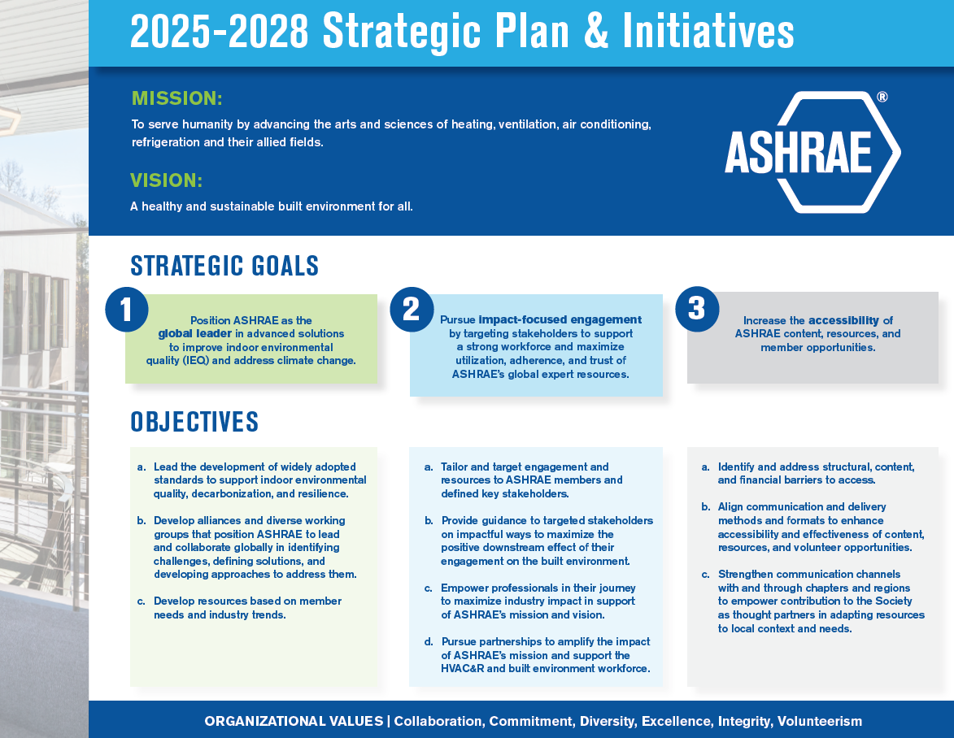

2025–2028 Strategic
Plan Preview
A preview of the 2025–2028 Strategic Plan is available for committees, councils and chapters to reference while planning for the upcoming 2025–2026 Society year. The formal implementation of the 2025–2028 Strategic Plan will occur in July 2025.
ashrae.org/strategicplan
Notes:
ASHRAE’s work is guided by a Strategic Plan. For example, the Communications Committees MBOs reflect goals and initiatives put forth in the ASHRAE Strategic Plan. It’s helpful to know about the Strategic Plan to understand the goals and initiatives of the Committee.
The 2019−2025 ASHRAE Strategic Plan Midterm Update includes a one-year extension of the 2019-2024 Strategic Plan with lessons learned during the COVID-19 pandemic as well as updates on rebooted/restarted initiatives including an update to Initiative 1 to focus on Resiliency and Decarbonization in Buildings.
A preview of the 2025–2028 Strategic Plan is available for committees, councils and chapters to reference while planning for the upcoming 2025–2026 Society year. The formal implementation of the 2025–2028 Strategic Plan will occur in July 2025.

Slide 4

Society Theme
Empowering Our Workforce: Building a Sustainable Future
M. Dennis Knight, P.E., BEMP, Fellow Life Member ASHRAE
2024-25 ASHRAE President
Notes:
New Society Theme each Society Year in conjunction with Presidential year and each President’s initiatives.
Great (simple – relevant – easy) to share at chapter meetings!
PPT, Manuscript and relevant videos available at ashrae.org/president

Slide 5

ASHRAE Society
53,000 members
Society Communications Committee
8 Board-appointed members including chair and vice chair
3-year terms
3 Councils + Board of Directors
100+ Staff | 3 office locations
16 Positions for Region Communications Chair
Liaison to the Society Communications Committee
Chapter Communication Committee Chair(s)
Region Communication Chair(s)
Reports to Members Council & works with all 3 Councils
200 Positions for Chapter Communication Chair
Interfaces with the Regional Communications Chair (RCC)
Notes:
Society Communications Committee responds to needs of the Regions, Chapters and Society, ensuring Communications policies and guidance are in adherence with Society policies. The chart here indicates how Society Communications Committee serves Society, the Regions and the Chapters and hints at the hierarchal structure. An example of how this is put into practice is when a chapter has a need voiced as a CRC motion, when that is passed, it can be referred to Society Communications Committee to address. Should your chapter have communications related needs they can be put forth as motions at your Region’s CRC. Often what one chapter has identified as a need is something that will help other chapters and groups as well.

Slide 6
ASHRAE Society
Society Communications Committee
Chapter Communication Committee Chair(s)
Region Communication Chair(s)
Communications Committee
ROB 2.405
The Society Communications Committee identifies the communication, collaboration and training needs for membership groups, recommends and maintains policies, and ensures that the implementation of information technologies meets the objectives and needs of the Society.
ashrae.org/communications
facebook.com/ashraecommunicationscommittee
Notes:
The committee meets at the Winter and Annual Conferences and has several conference calls between meetings.
Anyone is welcome to attend a meeting. For information on joining a meeting, please contact the committee's staff liaison Joslyn Ratcliff.

Slide 7


Next ASHRAE Conferences
 | Winter Conferences Jan. 31-Feb. 4, 2026 – Las Vegas, NV Jan. 23-27, 2027 – Chicago, IL Feb 5-9, 2028 - Orlando, FL
Annual Conferences
June 27 – July 1, 2026 – Austin, TX
June 12-16, 2027 – New Orleans, LA
Notes:
ASHRAE has winter and annual conferences. Keep in touch with ASHRAE by attending the conferences. If you attend, we’d love to invite you to attend the Communications Committee meeting as a welcome guest. Communications Committee traditionally meets on the Saturday of the conferences and their meeting times are always posted in the conference schedule. Feel free to reach out to ASHRAE Communications Committee Staff Liaison Joslyn Ratcliff jratcliff@ashrae.org for more information.

Slide 8
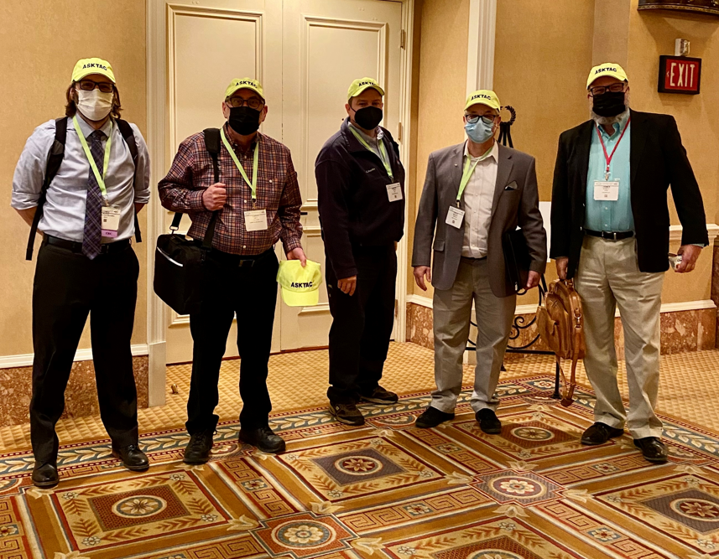
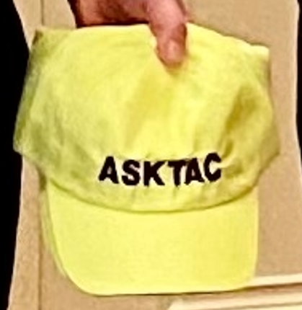
ASHRAE Technical Committees
The technical expertise of ASHRAE is concentrated in its Technical Committees (TCs), Task Groups (TGs),
Technical Resource Groups (TRGs) and Multidisciplinary Task Group (MTGs) .
These groups:
Prepare the text of ASHRAE Handbook chapters
Originate, coordinate and supervise Society-sponsored research projects
Present programs at ASHRAE meetings
Review technical papers
Evaluate the need for standards
Advise the Society on all aspects of the technology it embraces
2 Steps to Get Involved:
See what TC would be a good fit by reviewing the list of TCs.
Apply to be a member using the easy form.
ashrae.org/tcs
Notes:
If you are lucky, you might get a cool neon yellow TAC hat. The TCs contribute greatly to Society and have fun doing it.

Slide 9
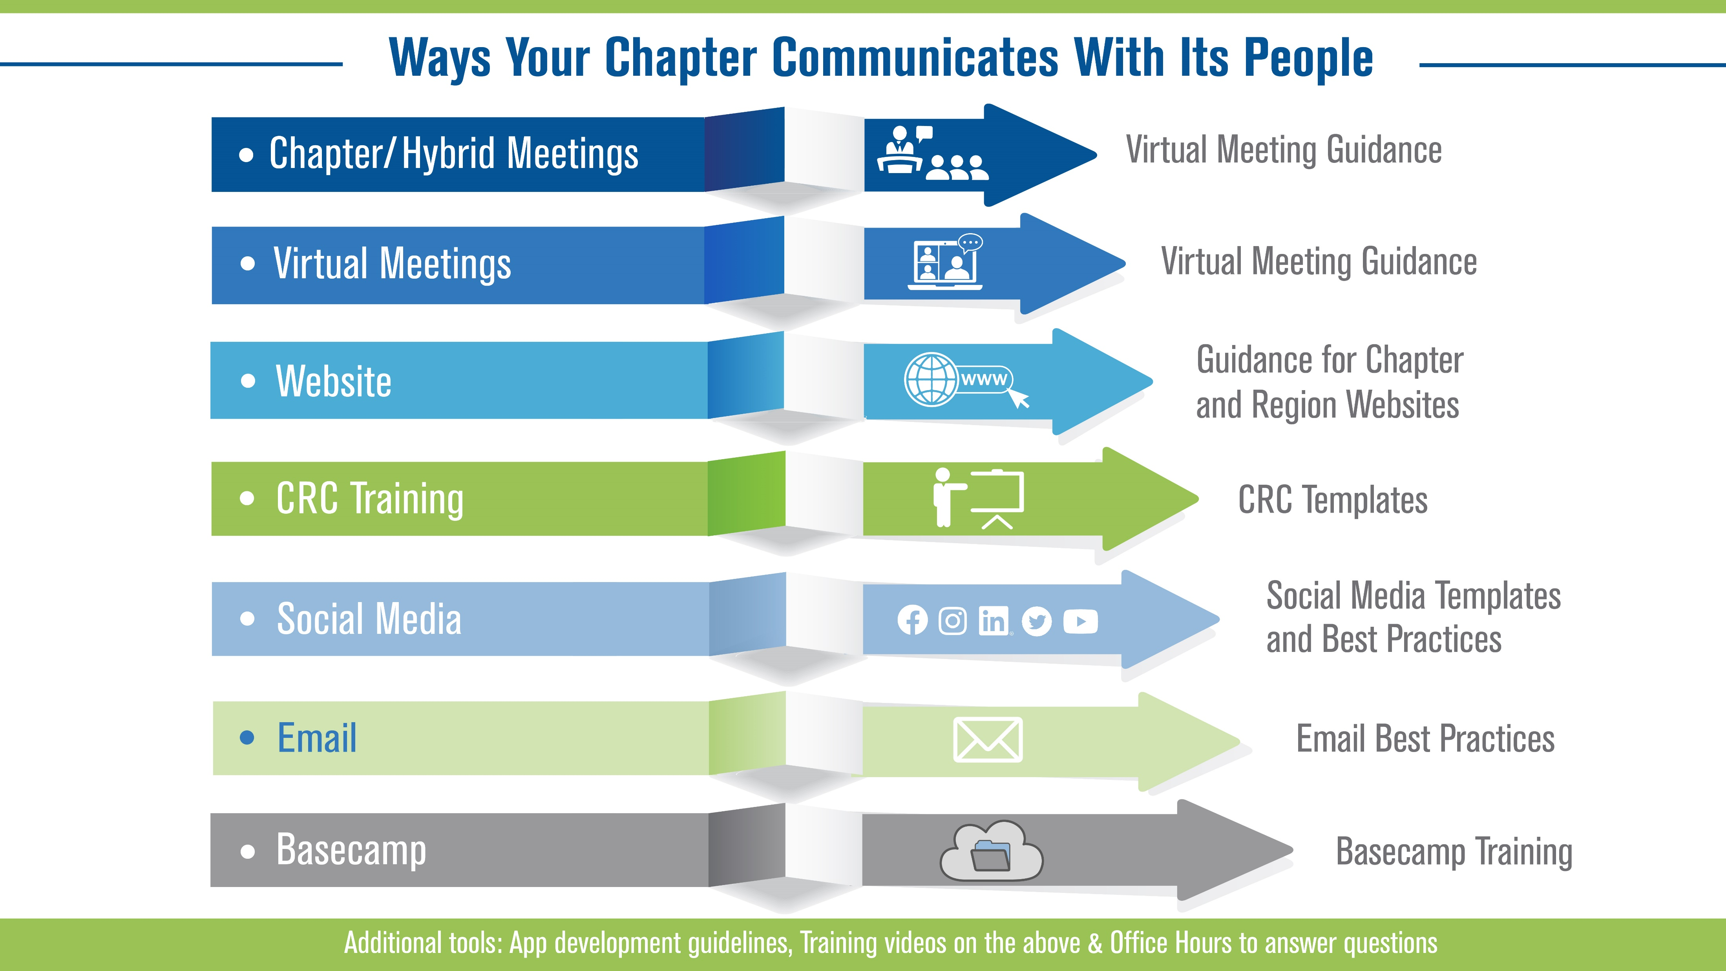
Notes:
This infographic shows the ways chapters generally communicate, along with the materials available from Communications Committee to help. Generally, if there is a communications need or effort, the Communications Committee will have tools, guidance or training to help.

Slide 10
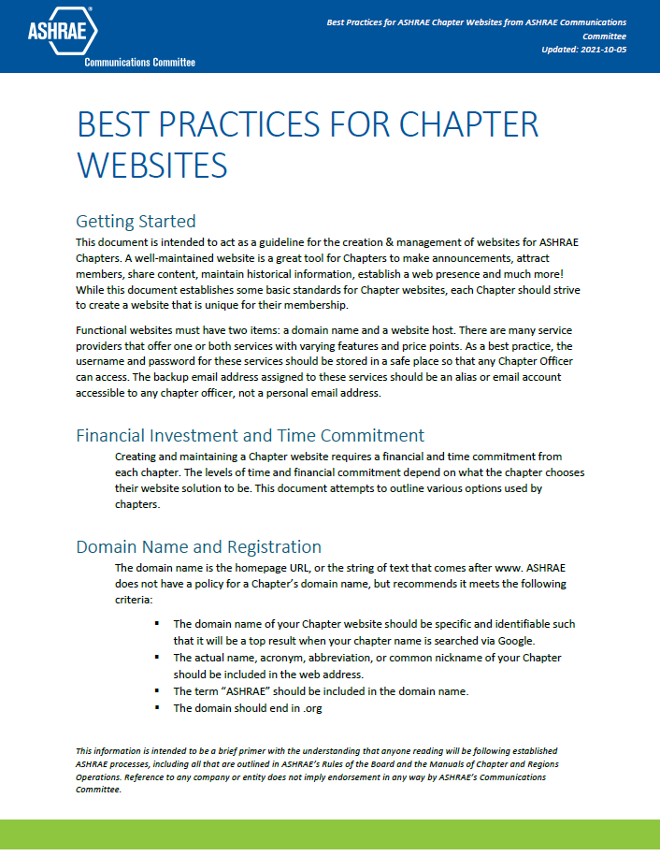
Website Best Practices
Will save you time!
Perfect for Chapter or Region Webmasters of Communications Chairs
Incudes free Wix template and WordPress theme
Covers do’s and don’ts of creating or maintaining a website for your ASHRAE chapter
ashrae.org/communications
Notes:
Written in clear language and easy to digest, this document was last updated in 2022 and provides a perfect start for anyone working with their chapter or region in a communications or website role. Includes contact information for additional questions. Reading this document from the Communications Committee will save volunteers time and effort.

Slide 11
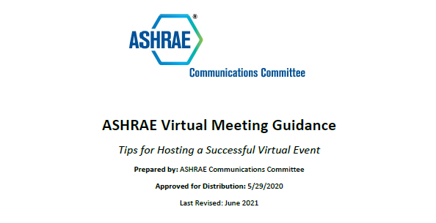
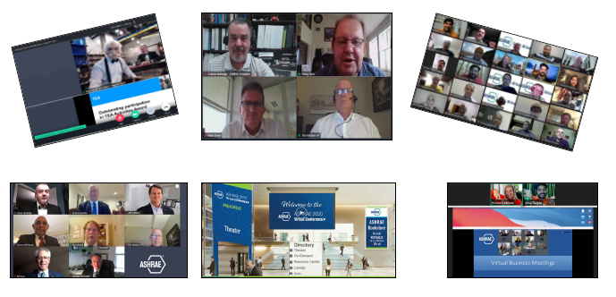
Virtual Meeting Guidance
Comprehensive document with links and a table of contents will help you plan and successfully execute a virtual event
A collaboration with Chapter Technology Transfer Committee (CTTC)
Great for individuals simply attending virtual events too!
ashrae.org/communications
Notes:
This document was written by ASHRAE members who are experts in hosting and holding ENGAGING and EFFECTIVE (i.e. not boring meetings where participants are multitasking and not engaged) meetings. Contains excellent practical advice as well as quick tips and tricks that will help anyone have a more effective meeting or simply appear more polished on-screen.

Slide 12
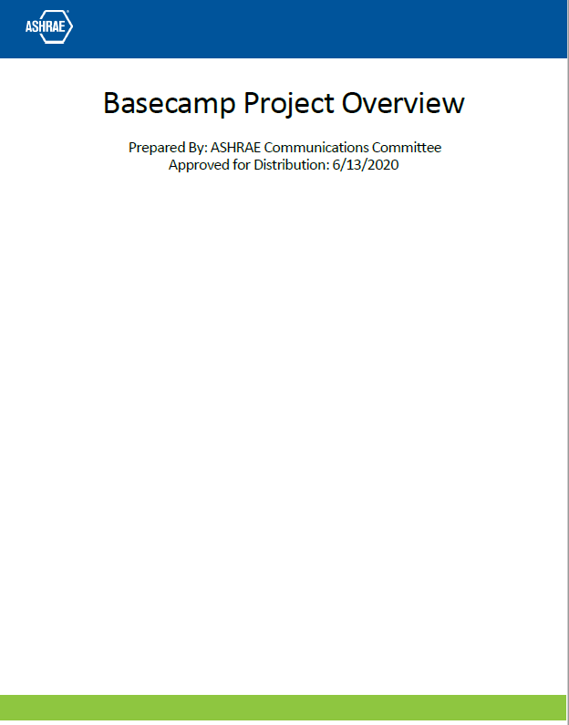
Basecamp
Oversees Basecamp use for Society
  New Basecamp project creation
  Old Basecamp project archiving
  Training (documents, videos, live training)
  Tips & Tricks and more!
  Need help or have questions? Start with the Basecamp Project Overview document.
ashrae.org/basecampguidance

Slide 13

Email Best Practices
How do I get my email delivered to my chapter?
What software do I use?
Where do I start?
ashrae.org/communications

Slide 14

Social Media Guidance
Social Media Best Practices PPT
Free Downloadable Planning Template
ASHRAE Content on YouTube
Notes:
Communications Committee resources can save you a ton of time in planning your chapter’s social media and keeping it current and engaging by using tried and true methods. A free downloadable planning template will make your social planning more formulaic and help with content ideas based on Society and chapter deadlines. If you still need help or have questions you can contact the Communications Committee staff liaison at any time – Joslyn Ratcliff jratcliff@ashrae.org . Or just email social@ashrae.org and Society’s social maven will respond back to you!

Slide 15
Questions?
How can we help?
ashrae.org/communications
facebook.com/ashraecommunicationscommittee
Notes:
Effective and regular communication is crucial to the growth and success of your chapter. Communications Committee has resources and knowledge to help you. Remember to check out our page on ashrae.org and follow us on Facebook.

Slide 16
Thank you!

